Slide 1




STATISTICAL METHODS FOR ANALYSING LOGISTICS DATA
Data Management
Slides to exercises
BAS4SC
Business Analytics Skills
for the Future-proofs Supply Chains
Project number – 2022-1-PL01-KA220-HED-000088856

Slide 2
Agenda
Data management
Relational database construction
Global model
Conceptual model
Logical model
Physical model
Conclusion

Slide 3
Data management
Apart from having a certain format the data may be organized in different ways to facilitate their management, processing and presentation.
Although data on their input are mostly unstructured, by their storage, transmission and processing their organization increases.
The usual forms of data organization by increasing complexity represent semi-structured (e.g., CSV) and structured (e.g., spreadsheets, databases, etc.) data formats:
  The first form of data organization is by two-dimensional arrays of fields, also called tables or spreadsheets.
  There are various forms of DB organization with the relational model (RDB) being the most common. The RDB model is based on the concept of entities and relations.
  Since there are usually no fixed paths of searching through the database files, various query languages (e.g., SQL) have been devised for data retrieval and manipulation.
Source: (W3 Schools, 2023)

Slide 4
Raw transaction data (CSV)
descriptor
transactions
Date,SellerID,CustomerID,TransactionID,ProductID,ProductPrice
1.10.24,1,12,1,101,195
1.10.24,1,12,1,102,45
1.10.24,1,12,1,103,35
1.10.24,2,14,2,104,55
1.10.24,2,14,3,101,195
2.10.24,3,15,4,105,85
2.10.24,3,15,4,101,195
2.10.24,3,15,4,103,35
2.10.24,3,16,5,104,55
2.10.24,1,17,6,101,195
2.10.24,1,17,6,102,45
...
CSV (Comma Separated Values)

Slide 5
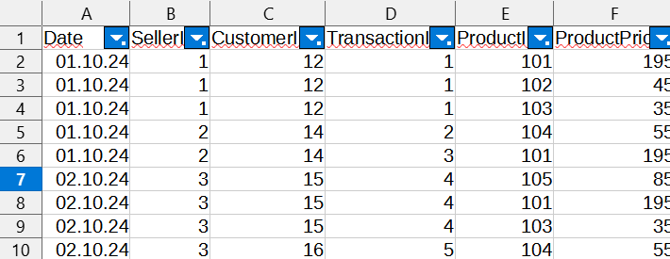
CSV to spreadsheet data
column
row
cell
Source: LibreOffice screenshot of the DB (2024) spreadsheet

Slide 6
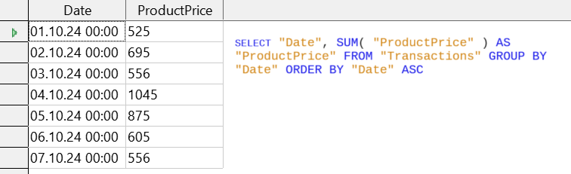
Spreadsheet to database data + SQL query
Source: LibreOffice screenshot of the DB (2024) database

Slide 7
Relational database construction
A relational database (RDB) can be constructed analytically (top-down) or synthetically (bottom-up)
Depending on the information available:
  the first approach corresponds with building the database from scratch
  The second approach corresponds with building the database from a collection of sorted data by attributes (e.g. from a spreadsheet)
The main benefit of using a RDB is that the tables involved are interconnected by keys:
  primary keys (unique) make it easy to find appropriate rows of data
  secondary keys make it easy to interconnect related tables by specific attributes that appear as references on one and as primary keys on the other side

Slide 8
Global model
Goods
Supplier
Store
Order

Slide 9
Conceptual model (E-R diagram)
Product
1 K
Order
Supplier
1 M
N 1
Store
Order_ID
Date
Quantity

Slide 10
Logical model
When all relevant identifiers and interconnections among tables are established, a logical model (relational schema) can be set:
  SUPPLIER (Supplier_ID#, Supplier_name, Supplier_contact)
  STORE (Store_ID#, Store_name, Store_address)
  ORDER (Supplier_ID#, Store_ID#, Order_ID#, Date, Quantity, EPC)
  PRODUCT (EPC#, Product_name, Product_price)
A relational schema can be implemented in any RDBS.

Slide 11
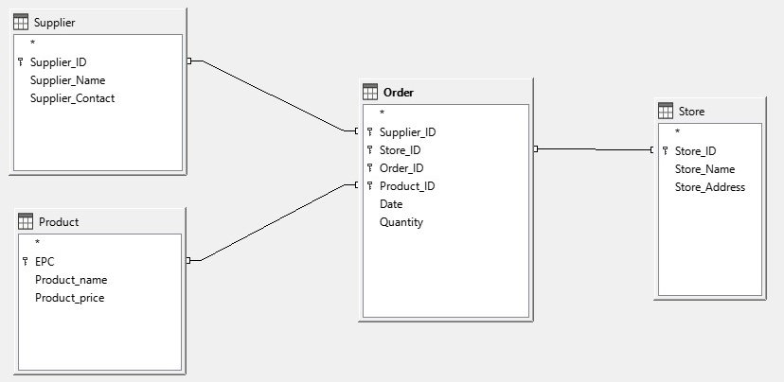
Logical model
entity
keys
relation
Source: LibreOffice screenshot of the MyStore (2024) database

Slide 12
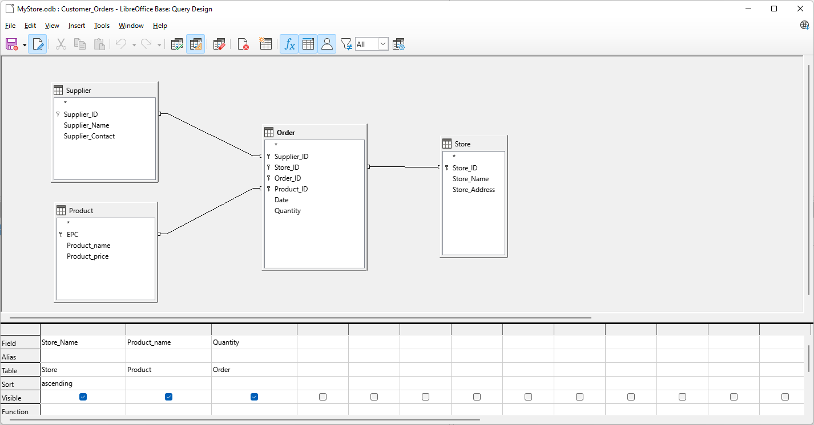

Physical model

Slide 13
Data exploration
Query languages are mainly of two types:
  Structured Query Language (SQL) and
  Query by Example (QBE).
While SQL (on previous slide) is considered a programming language and a DBMS’s API, QBE (on next slide) is mainly used with the DBMS directly for DB management and data warehousing.
Queries produce tables of results, which can be used for building data warehouses or reused in further queries.
Source: (W3 Schools, 2023)

Slide 14
Conclusion
In this example an analytical approach to RDB construction has been outlined.
Feel free to „play” with the database and devise new searches, reports, etc.

Slide 15
Thank you for your attention

