Slide 1


Advanced spreadsheet application for logistics data analysis
Case study
CHOOSING A LOGISTICS SERVICE PROVIDER
BAS4SC
Business Analytics Skills
for the Future-proofs Supply Chains
Project number – 2022-1-PL01-KA220-HED-000088856

Slide 2
Agenda
Case Study Objective
Boundary Conditions
Task Flow

Slide 3
Purpose of the case study
Main objective:
  selection of a logistics operator based on a comprehensive analysis of logistics offers
  prediction of results based on historical data
Detailed objectives:
  Development of analytical competences – comparing offers based on data
  Practical application of knowledge – formulating recommendations for selecting the best logistics operator
Effect of the case study implementation:
  Acquiring practical knowledge and skills and developing decision-making skills based on data analysis

Slide 4
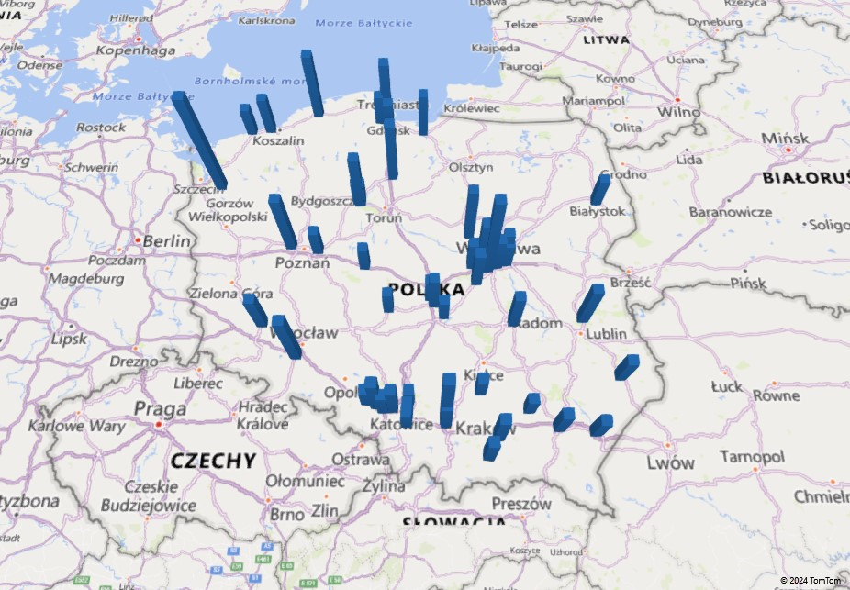
Map showing the customer volume served

Slide 5
A chart showing the sum of pallet spaces and the number of shipments delegated to the logistics operator

Slide 6
A chart showing the number of pallet spaces versus time

Slide 7
New recipients located by zip codes
Zip code | Additional Pallets per day
1 | 10
5 | 15
12 | 9
14 | 14
21 | 5
27 | 12
30 | 15
41 | 8
44 | 13
51 | 15
62 | 5
64 | 6
71 | 5
80 | 12
90 | 10
95 | 7

Slide 8
Task progress
Choose a logistics operator that offers the lowest total fee over the entire period
Compare prices from different logistics operators and identify potential savings
Indicate risks associated with the forecast
Prepare a forecast for each customer based on data,
Indicate key recommendations

Slide 9
Questions
Comments and Remarks
Conclusions

