Slide 1
Advanced using of spreadsheet to analyze logistics data
Analytics in the Area of Supply and Purchasing
Lecture
BAS4SC
Business Analytics Skills for the Future-proofs Supply Chains
Project number – 2022-1-PL01-KA220-HED-000088856

Slide 2
Agenda
the role and importance of procurement and purchasing;
procurement and purchasing strategies;
selected methods of evaluating and selecting suppliers.

Slide 3
Supply logistics
Supply (supply logistics) is assigned to both basic and auxiliary functions. It contributes to gaining competitive advantage through, among others, selecting suppliers who:
offer high-quality raw materials at the lowest possible price, contributing to increased customer satisfaction;
guarantee innovative technologies, which translates into introducing new solutions and products to the market;
apply sustainable practices that reduce waste and improve the company's image.

Slide 4
Supply definition
Supply allows for obtaining equipment, materials and components necessary to produce one's own finished product or for selling goods to subsequent links in the supply chain.
Supply also includes activities related to the analysis of the available (current) stock of materials and components that are at the company's disposal.
Supply also includes supervising and responding to changes in delivery conditions (changes in the date, assortment, quantity, etc.). Therefore, it means obtaining something in a planned manner.
Source: Coyle, Bardi, Langley, 2002

Slide 5
Purchasing definition
Purchasing is one of the stages of supply logistics. It means purchasing goods and services.
The concept of purchasing should be understood as an exchange transaction that begins when material needs are known.
It therefore includes four stages:
specifying the type of purchase;
determining the necessary level of expenditure;
implementing the actual purchasing process;
assessing the effectiveness of the completed purchasing process.
Source: Kowalska, 2005

Slide 6
Sourcing and purchasing strategies
Due to the possible sources of supply we can distinguish:
single source of supply (one supplier) – (single sourcing) means that based on established criteria, one supplier is selected, who is responsible for the supply of a specific assortment item or assortment group;
two sources of supply (two suppliers) – (dual sourcing) which means purchasing from two equal suppliers who supply the same type of product range or group of products;
multiple sources of supply (multiple suppliers) – (multiple sourcing) means using the services of multiple suppliers and subcontractors. This strategy ensures high supply security.
Source: Grzybowska, 2011

Slide 7
Sourcing and purchasing strategies
Due to the subject of the purchase we can distinguish:
purchases of individual elements (unit sourcing), which is directed to manufacturing companies that purchase the subject of the purchase in the form of uncomplicated components (simple elements: parts, details, etc.), from which they then produce a finished product;
modular purchases (modular sourcing), which means moving away from acquiring individual elements in favour of ready-made assembly modules or complex components that are assembled into a final product.
Source: Grzybowska, 2011

Slide 8
Supplier Evaluation and Selection Methods
evaluation method used
minimum order quantity
sourcing strategy
supplier production capacity
product type
type of supplier evaluation
supplier location preferences
supplier selection criteria
production strategy
supplier production capacity
Supplier selection is the basis for long-term supplier partnerships that can significantly contribute to the success or failure of a company.
The decision-making process for supplier evaluation and selection is influenced by the following elements:
Source: Ali et al., 2023; Nowakowski & Werbińska-Wojciechowska, 2012; de Boer, et al. 2001

Slide 9
Supplier Evaluation and Selection Methods
We can distinguish numer of methods and techniques for supplier evaluation and selection:
elimination methods, which help companies in the supplier selection process by gradually eliminating those who do not meet certain criteria (e.g. point method);
optimization methods, which help companies make decisions regarding the selection of the best suppliers based on various criteria (e.g. AHP method);
probabilistic methods, which consider uncertainty and variability of data in the decision-making process (e.g. TOPSIS method).
Source: Benyoucef et al., 2003

Slide 10
Supplier evaluation criteria
Assessment criteria
Price/costs and payment terms
Delivery terms
Goods quality
Supplier potential
Determining the right criteria for supplier evaluation enables the best possible choice to be made later. These criteria influence and determine the evaluation of subcontractors’ offers.
Figure 1. Selected supplier evaluation criteria
Source: Midor & Biały, 2019

Slide 11
Supplier evaluation criteria
Evaluation criterion | Characteristic parameters
Price/costs and payment terms | price competitiveness price stability or variability over a longer period of time payment terms possibility of crediting the delivery | scope of discounts granted for larger orders scope of discounts granted for long-term cooperation willingness to negotiate prices delivery costs | transport costs hidden (additional) costs not directly visible in the price offer quality-related costs related to complaints, returns, repairs
Deliveries | timeliness of deliveries regularity of deliveries frequency of deliveries completeness of deliveries | accuracy/assortment consistency of deliveries method of packaging and securing goods quantitative flexibility of deliveries timely flexibility of deliveries | convenience of placing orders possibility of managing the logistics of deliveries by the supplier (e.g. transport, storage) reliability of deliveries
Product quality | technical quality of the product quality guarantees product reliability technical service | product compliance with norms and standards product functionality product durability quality control system | product safety ease of repair or maintenance of the product impact of the product on the natural environment (ecological character)
Supplier potential | production capacity technological availability availability of technical, human and material resources | innovation potential logistic and operational efficiency supplier experience management and organisational capabilities | supplier's market position (market share; reputation) possibilities of introducing new technologies, products or processes
Source: own study

Slide 12
Weighted Point Method
The most used quantitative supplier evaluation method.
The order of selected supplier evaluation criteria is first determined and a weighted factor (weight) is assigned to them.
The weighted factor refers to the importance of the selected evaluation criterion.
Source: Burdzik, 2017

Slide 13
Weighted Point Method
The weighted coefficient should:
Be in the range $<0,1>$,
Each subsequent weighted coefficient used is smaller than its predecessor $π_{i}>π_{i+1}>π_{i+2}$,
The sum of all weighted coefficients must be equal to 1: $\sum_{1}^{n}{π_{i}}=1$,
The number of weighted coefficients depends on the number of criteria analyzed.
The supplier's evaluation is obtained by multiplying each criterion score by a predetermined weighted factor.
Then, the obtained values are summed.
The preference score (P_{S}) denotes the supplier's evaluation
$P_{S}=\sum_{y=1}^{n}{\left(O_{i}•π_{i}\right)}$
P_{S} – preference score
O – criterion evaluation
$π_{}$– weighted coefficient.
Weighted Point Method formula used in Excel
preference score_{(supplier 1)} = (rating_{(criterion 1)} * ω₍₁₎) + (rating_{(criterion 2)} * ω₍₂₎) + (rating_{(criterion 3)} * ω₍₃₎) + (rating_{(criterion 4)} * ω₍₄₎) + (rating_{(criterion 5)} * ω₍₅₎)
Source: Burdzik, 2017

Slide 14
Weighted Point Method – an Example
Evaluate suppliers for the selected assortment item. To do that follow steps below:
Prepare a data sheet; list the criteria and assigning weighted coefficients.
Establish a scale of assessment of individual criteria.
Establish a set of suppliers subject to assessment; assign assessments to individual criteria and suppliers.
Calculate a weighted average for each supplier subject to assessment.
Draw a graph containing the criteria and their assessment by suppliers.
Perform an analysis and, on its basis, selecting the best supplier; determining which supplier will receive the best assessment.

Slide 15
Weighted Point Method – an Example
The selected criteria are:
Quality of the bicycle part (parts do not break, are durable, no complaints),
Price of the bicycle part (the lower the better),
Timeliness of deliveries (deliveries are delivered on time),
Reliability of deliveries (products arrive intact, without damage),
Compliance of the goods with expectations (the goods arrive exactly as ordered),
Ordering procedure (simple and intuitive ordering).
The assigned weighted coefficients are as follows:
Quality of the bicycle part – 30%,
Price of the bicycle part – 25%,
Timeliness of deliveries – 15%,
Reliability of deliveries – 10%,
Compliance of the goods with expectations – 10%,
Ordering procedure – 10%.

Slide 16
Weighted Point Method – an Example
The assessment of individual criteria will be made based on a 10-point assessment (1-10), where:
10 – Very good (perfect fulfillment of the criterion),
7–9 – Good (minor problems),
4–6 – Average (partial fulfillment, a few problems),
2–3 – Poor (numerous problems),
1 – Very bad (no fulfillment of the criterion).
Five companies supplying bicycle parts were selected for the supplier assessment. These are companies coded: A1, B2, C3, D4, E5.

Slide 17
Weighted Point Method – an Example
Excel example:
Prepare a spreadsheet with data; list the criteria and assign weighted coefficients.
Define the scale of evaluation of individual criteria according to the established scale and assign them to each supplier who is subject to evaluation.

Slide 18
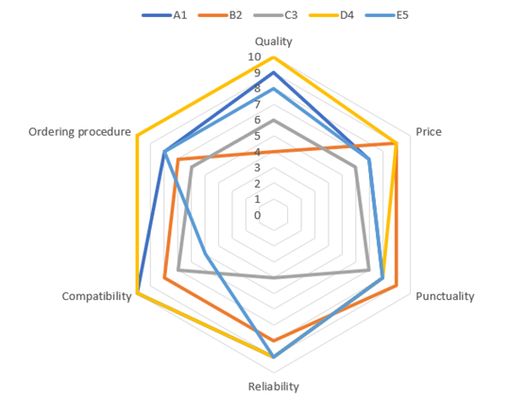
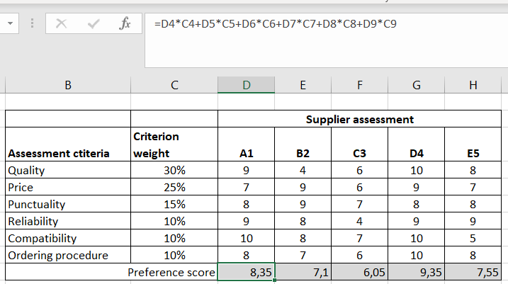
Weighted Point Method – an Example
Draw a chart containing the criteria and their assessment by suppliers. To visualize the result, it is worth making a radar chart.
Calculate the weighted averages for each supplier being assessed; The formula for calculating the weighted average for a single supplier is shown below.

Slide 19
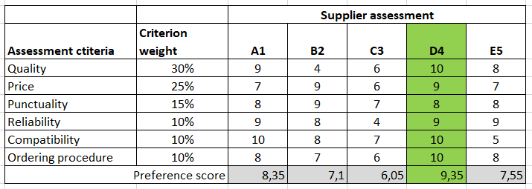
Weighted Point Method – an Example
Perform the analysis and select the best supplier based on it; determine which supplier received the best rating.
To determine the supplier that best meets the criteria adopted during the analysis, the supplier with the highest preference score is selected

Slide 20
Multi-criteria Method
The Analytic Hierarchy Process (AHP) is a commonly used procedure for solving problems related to strategic decisions, also for evaluating and selecting suppliers.
AHP is a common multi-criteria decision-making method.
It considers both subjective and objective evaluation measures.
AHP uses a pairwise comparison of evaluation criteria with respect to an objective.
Source:Ossadnik & Lange, 1999; Dweiri et al., 2016

Slide 21
Multi-criteria Method
AHP
hierarchical structure
priority analysis
consistency verification
Source: Cheng et al., 2007

Slide 22
Multi-criteria Method – an Example
Evaluate suppliers for the selected assortment item. To do that follow steps below:
Prepare data sheet; List the criteria.
Compare criteria in pairs (scale 1, 3, 5).
Calculate the sum for each criterion.
Calculate the share of each cell in the sum for each criterion.
Calculate global preferences for each criterion.
Show global preferences for each criterion.
Indicate suppliers (A1, B2, C3, D4).
Calculate local preferences for each criterion and supplier.
Calculate the share of each cell in the sum for each criterion and supplier.
Calculate local preferences for each criterion and supplier.
Show local preferences for each supplier for a given criterion.
Establish a ranking of suppliers.
Select a supplier.

Slide 23
Multi-criteria Method – an Example
The selected criteria are:
Quality of the bicycle part (parts do not break down, are durable, no complaints),
Price of the bicycle part (the lower the better),
Timeliness of deliveries (deliveries are delivered on time),
Reliability of deliveries (products arrive intact, without damage)
The scale of comparison of criteria was selected:
1 – just as good / important,
2 – slightly better / more important,
3 – definitely better / more important,
4 – much better / more important,
5 – extremely better / more important.

Slide 24
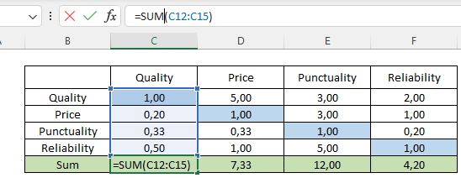
Multi-criteria Method – an Example
Calculate the sum for each criterion in the column.
Excel example:
Prepare a data sheet; list the criteria.
Compare criteria in pairs (scale 1, 3, 5).

Slide 25
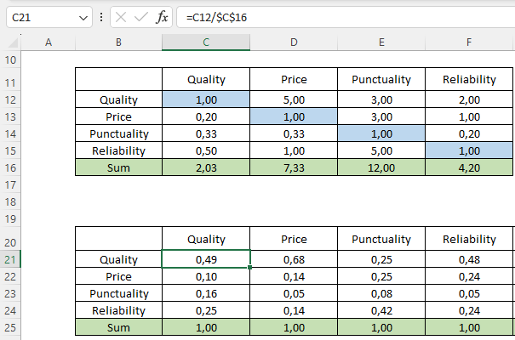
Multi-criteria Method – an Example
Calculate global preferences for each criterion.
Count the share of each cell in the total for each criterion.

Slide 26
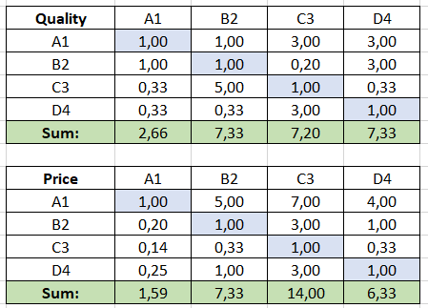
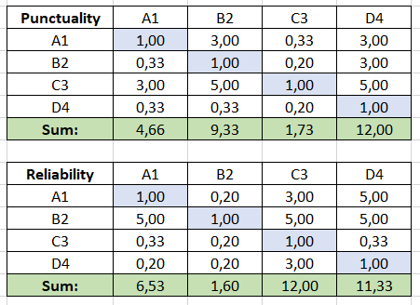
Multi-criteria Method – an Example
Show global preferences for each criterion.
Indicate suppliers (A1, B2, C3, D4).
Compare suppliers in pairs according to each criterion (scale 1-7).

Slide 27
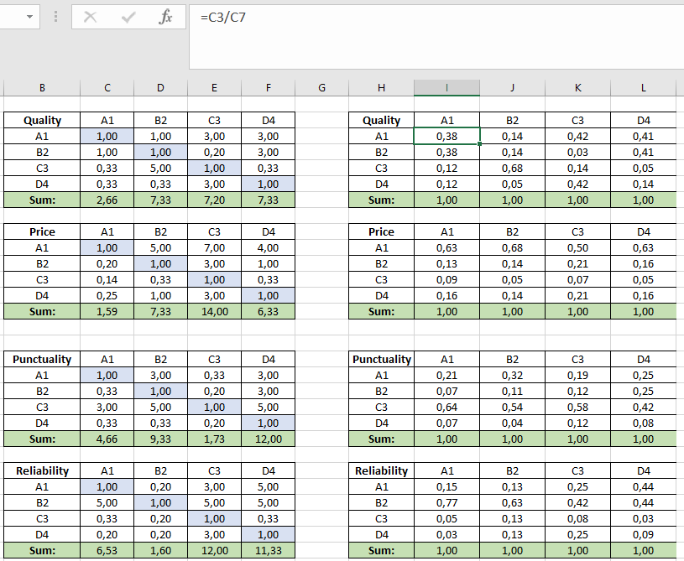
Multi-criteria Method – an Example
Calculate the share of each cell in the total for each criterion and supplier.

Slide 28
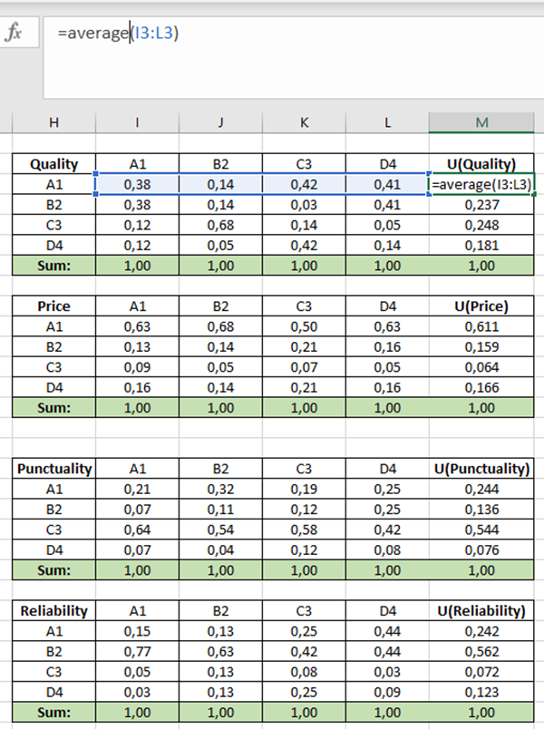
Multi-criteria Method – an Example
Calculate local preferences for each criterion and supplier.

Slide 29
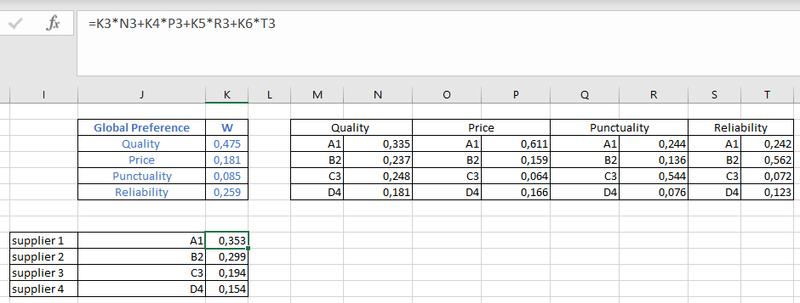
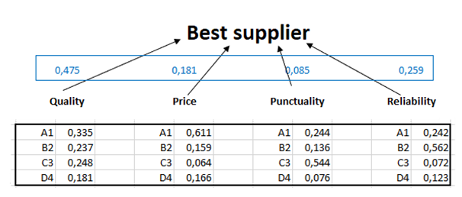
Multi-criteria Method – an Example
Show local preferences for each supplier with respect to a given criterion.
Establish a supplier ranking.
Select a supplier.

Slide 30
Summary
Supply allows for obtaining equipment, materials and components necessary to produce one's own finished product or for selling goods to subsequent links in the supply chain and the concept of purchasing is an exchange transaction that begins when material needs are known;
Supplier selection is the basis for long-term supplier partnerships;
Weighted Point Method is the most used quantitative supplier evaluation method;
The Analytic Hierarchy Process (AHP), a common multi-criteria decision-making method, is a used for solving problems related to strategic decisions, also for evaluating and selecting suppliers.

Slide 31
Thank you for your attention

