Slide 1
Advanced using of spreadsheet to analyze logistics data
Data Visualization Methods
Lecture
BAS4SC
Business Analytics Skills for the Future-proofs Supply Chains
Project number – 2022-1-PL01-KA220-HED-000088856

Slide 2
Agenda
the needs for using data visualization and its benefits;
types of data visualization – when and what visualizations to use;
comparison of charts with respect to their properties;
describing dashboards;
describing the concept of building dashboards.

Slide 3
Data visualization
Charts and dashboards are clear and effectively facilitate understanding of the data;
Visualization methods help analyze data and transform it into information and knowledge about business;
All kinds of data visualizations allow for better understanding;
Visualizations allow to pay attention to the most important things, deviations and trends;
Presenting data on charts, maps and dashboards converts data into information, which may result in getting closer to the knowledge needed to make business decisions.
Source: Graudina & Grundspenkis (2005)
Hansoti (2010)

Slide 4
Data visualization
Data understanding
Making business decisions
Data analysis support
Acquiring knowledge about business
Making conclusions
Source: own elaboration

Slide 5
Data visualization - tools
MS Excel
Power BI
Qlik
Tableau
Google Data Studio
The data visualization methods themselves develop with the development of technology, mainly BI tools;
It was the development of BI that popularized Dashboards, which allow users to analyze and monitor data in real time.
Source: Tezel, Koskela, Tzortzopoulos (2009). The functions of visual management.

Slide 6
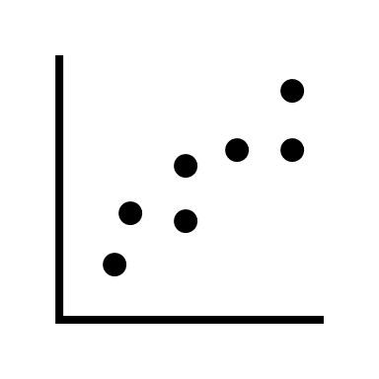
Charts
There are many types of charts, including:
column charts;
bar charts;
line charts;
pie charts;
area charts;
stock charts;
surface charts;
radar charts;
donut charts;
point charts;
funnel charts;
scatter charts;
histograms;
heat maps;
tree maps.
Source:Hansoti, 2010

Slide 7
Charts
The choice of chart should be adapted to the type of data being analyzed and should be conditioned by the need for the analysis being performer;
All kinds of data visualizations allow for better understanding;
Presenting data on charts, maps and dashboards converts data into information, which may result in getting closer to the knowledge needed to make business decisions.
Source:Hansoti, 2010

Slide 8
Charts
Column / bar chart
Data over time
Per category
Line chart
Data over time
Deviations
Stock chart
Trends
Data over time
Pie chart
Per category
Participation
Source: own elaboration

Slide 9
Clustered column chart
Yes
Correctly shows the measure of time
Accessible to the general community
No
Suitable for trend analysis
Good for presenting relationships between variables
Perfect for comparing category sizes
Effective in showing percentage data
How to do it in MS Excel: Insert -> Clustered column chart
Source: own elaboration

Slide 10
Stacked column chart
Yes
Correctly shows the measure of time
Accessible to the general community
No
Suitable for trend analysis
Good for presenting relationships between variables
Perfect for comparing category sizes
Effective in showing percentage data
How to do it in MS Excel: Insert -> Stacked column chart
Source: own elaboration

Slide 11
Pie chart
Yes
Perfect for comparing category sizes
No
Suitable for trend analysis
Effective in showing percentage data
Accessible to the general community
Correctly shows the measure of time
Good for presenting relationships between variables
How to do it in MS Excel: Insert -> Pie chart (2D)
Source: own elaboration

Slide 12
Line chart
Yes
Suitable for trend analysis
No
Perfect for comparing category sizes
Effective in showing percentage data
Correctly shows the measure of time
Good for presenting relationships between variables
Accessible to the general community
How to do it in MS Excel: Insert -> Line chart-> + -> Trend line-> view options -> display the equation on a chart
Source: own elaboration

Slide 13
Stock chart
Yes
Suitable for trend analysis
No
Perfect for comparing category sizes
Correctly shows the measure of time
Good for presenting relationships between variables
Accessible to the general public
Effective in showing percentage data
How to do it in MS Excel: Insert -> recommended charts -> all charts -> Stock chart
Source: own elaboration

Slide 14
Charts
Radar chart
Histogram / Pareto
Geolocation
Data over time
A map
Category scale
Category share
Per category
Feature ratings
Multifunctionality
Combo Chart
Data over time
Source: own elaboration

Slide 15
Radar chart
Yes
Perfect for comparing category sizes
No
Effective in showing percentage data
Suitable for trend analysis
Correctly shows the measure of time
Accessible to the general community
Good for presenting relationships between variables
How to do it in MS Excel: Insert -> recommended charts -> all charts-> Radar chart
Source: own elaboration

Slide 16
Histogram
Yes
Accessible to the general community
No
Effective in showing percentage data
Suitable for trend analysis
Correctly shows the measure of time
Good for presenting relationships between variables
Perfect for comparing category sizes
How to do it in MS Excel: Insert -> recommended charts -> all charts-> Histogram
Source: own elaboration

Slide 17
Pareto chart
Source: own elaboration
How to do it in MS Excel: Insert -> recommended charts -> all charts-> Histogram -> Pareto

Slide 18
A map
Yes
Effective in showing percentage data
No
Suitable for trend analysis
Correctly shows the measure of time
Good for presenting relationships between variables
Accessible to the general community
Perfect for comparing category sizes
How to do it in MS Excel: Insert -> recommended charts -> all charts-> Map
Source: own elaboration

Slide 19
Combo Chart
Yes
Suitable for trend analysis
No
Correctly shows the measure of time
Good for presenting relationships between variables
Effective in showing percentage data
Accessible to the general community
Perfect for comparing category sizes
How to do it in MS Excel: Insert -> recommended charts -> all charts-> Histogram -> Combo chart-> select the chart type and select the secondary axis
Source: own elaboration

Slide 20
Dashboard
Dashboards are a collection of many charts, maps and tables that enable monitoring and analyzing data, KPIs and operational and financial results;
Dashboards can present results in real time and can be fully flexible and cascading;
The interactivity of dashboards allows to deepen analysis and move from general to specific;
The purpose of Dashboards is to support business management, i.e., the data must provide information needed to make business decisions
Source: powerbi.microsoft.com

Slide 21
Dashboard
Dashboard
Real-time data
Possibility to expand the analysis
Cascading - from general to detail
Many charts, tables, maps
Flexibility
Full monitoring of indicators/ measures
Source: powerbi.microsoft.com, 2023

Slide 22
Dashboard – step by step
Define your audience and goals
For whom?
Choose your data
What is important?
Select visualizations
How to visualize?
Use template
Keep it simple
Repeat and improve
Does anyone have an idea how to do this better?
Less means more
Can I use the template??
What for?
Is it correct?
Is it readable??
Has anyone done this before?
Isn't there too many colors?
Isn't there too much information
Does everyone understand the dashboard?
Source: https://www.tableau.com 2023

Slide 23
Dashboard - application
Customer metrics
Financial information
Sales information
Web analytics
Manufacturing information
Human resources data
Marketing performance
Logistics information
Dashboards
There is practically no field in which dashboards cannot be used to improve processes and make the right business decisions. Data visualization using dashboards builds employee awareness of operations in virtually every possible process.
Source: https://www.tableau.com 2023

Slide 24
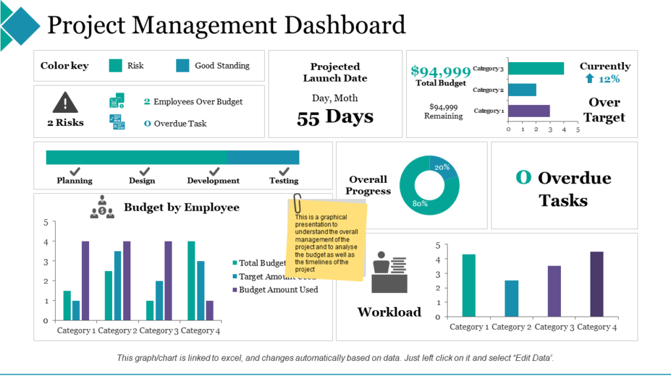
Dashboard
Source: slideteam.net, 2023
Source: slideteam.net, 2023

Slide 25
Summary
data visualization is knowledge;
data visualization and dashboards build managerial awareness;
data analysis supports business decision-making;
there are many forms of charts, you need to know which ones to use for which data;
using analyzes you can build a competitive advantage.

Slide 26
Thank you for your attention

